Slide 1



DROP
By Jonny Kidney
Jonny Kidney – Writer/Producer
jonnykidney@gmail.com
P: 604-561-5976
Jonnykidney.com

Slide 2

LOGLINE:
A world famous DJ returns to the spotlight after her struggles with fame, while overcoming a troubled past, filled with a secret. As glamourous as her life seems to be, she’s filled with doubt about her life altering decisions ahead.
GENRE:
Drama

Slide 3



Drop Script
SIZZLE REEL
Click here for a mock sizzle reel
Synopsis:
Simonne, an international DJ in her 30’s, is from very humble beginnings, but has lived, travelled and partied enough for five lifetime’s over. After dropping away from big events, to get her habits under wraps, she decides to step back into the major festival scene in Miami for the first time in a few years. Her only friend, and Manager, Adam, continues to support her, while she talks about hanging it all up for good, and starting a quiet, private life. But, Adam feels like playing the stage is what she was born to do.
After a hiatus, Simonne travels to Miami to headline the Winter Festival. Everything about going back to big festival’s reminds her of her dead girlfriend, Lynn, who shared her crazy journey to stardom, and along the way becoming jealous and out of control until finally she took her own life, or did she?
Heather, a journalist, and Lynn’s younger siister, pop’s by to say hi, which stirs up more memories, both good and bad. Heather always had a childhood crush on Simonne. While she’s hanging around, Heather stumbles across an importing drug ring right inside the festival involving one of it’s promoter’s, Hershey, who warnds her that she better tread lightly.
Glimpses of the past coincides with the present while Simmone wrestles with her demons, including a disturbing secret that may finally confront her, she’s faced with a life decision that will ultimately affect her future.
While playing one night at the festival, Simonne thinks she sees Lynn standing in the crowd.
As exciting and glamorous as her life seems to her fans, Simonne confides in Adam, constantly zig zagging her direction within the music industry, wishing for something more, and perhaps Heather can help her attain it, but she can’t shake quite shake her indecisions about performing.
Just when Simonne thinks she’s done with the whole thing, she steps up on stage for one final exhiliarting performance.

Slide 4

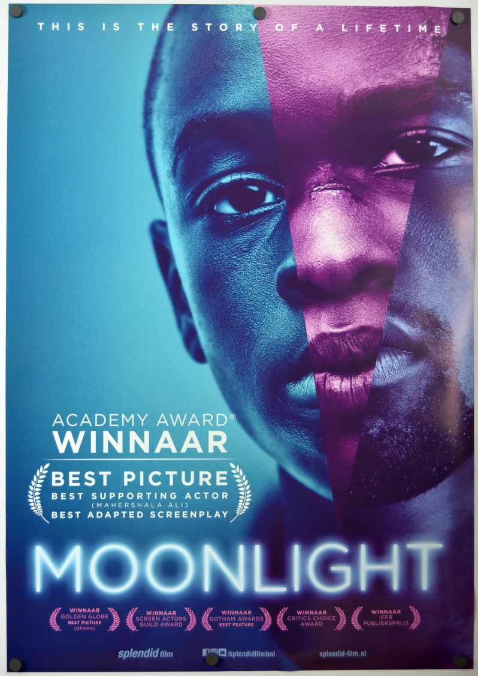


PRODUCTION CROSS
+
+

Slide 5

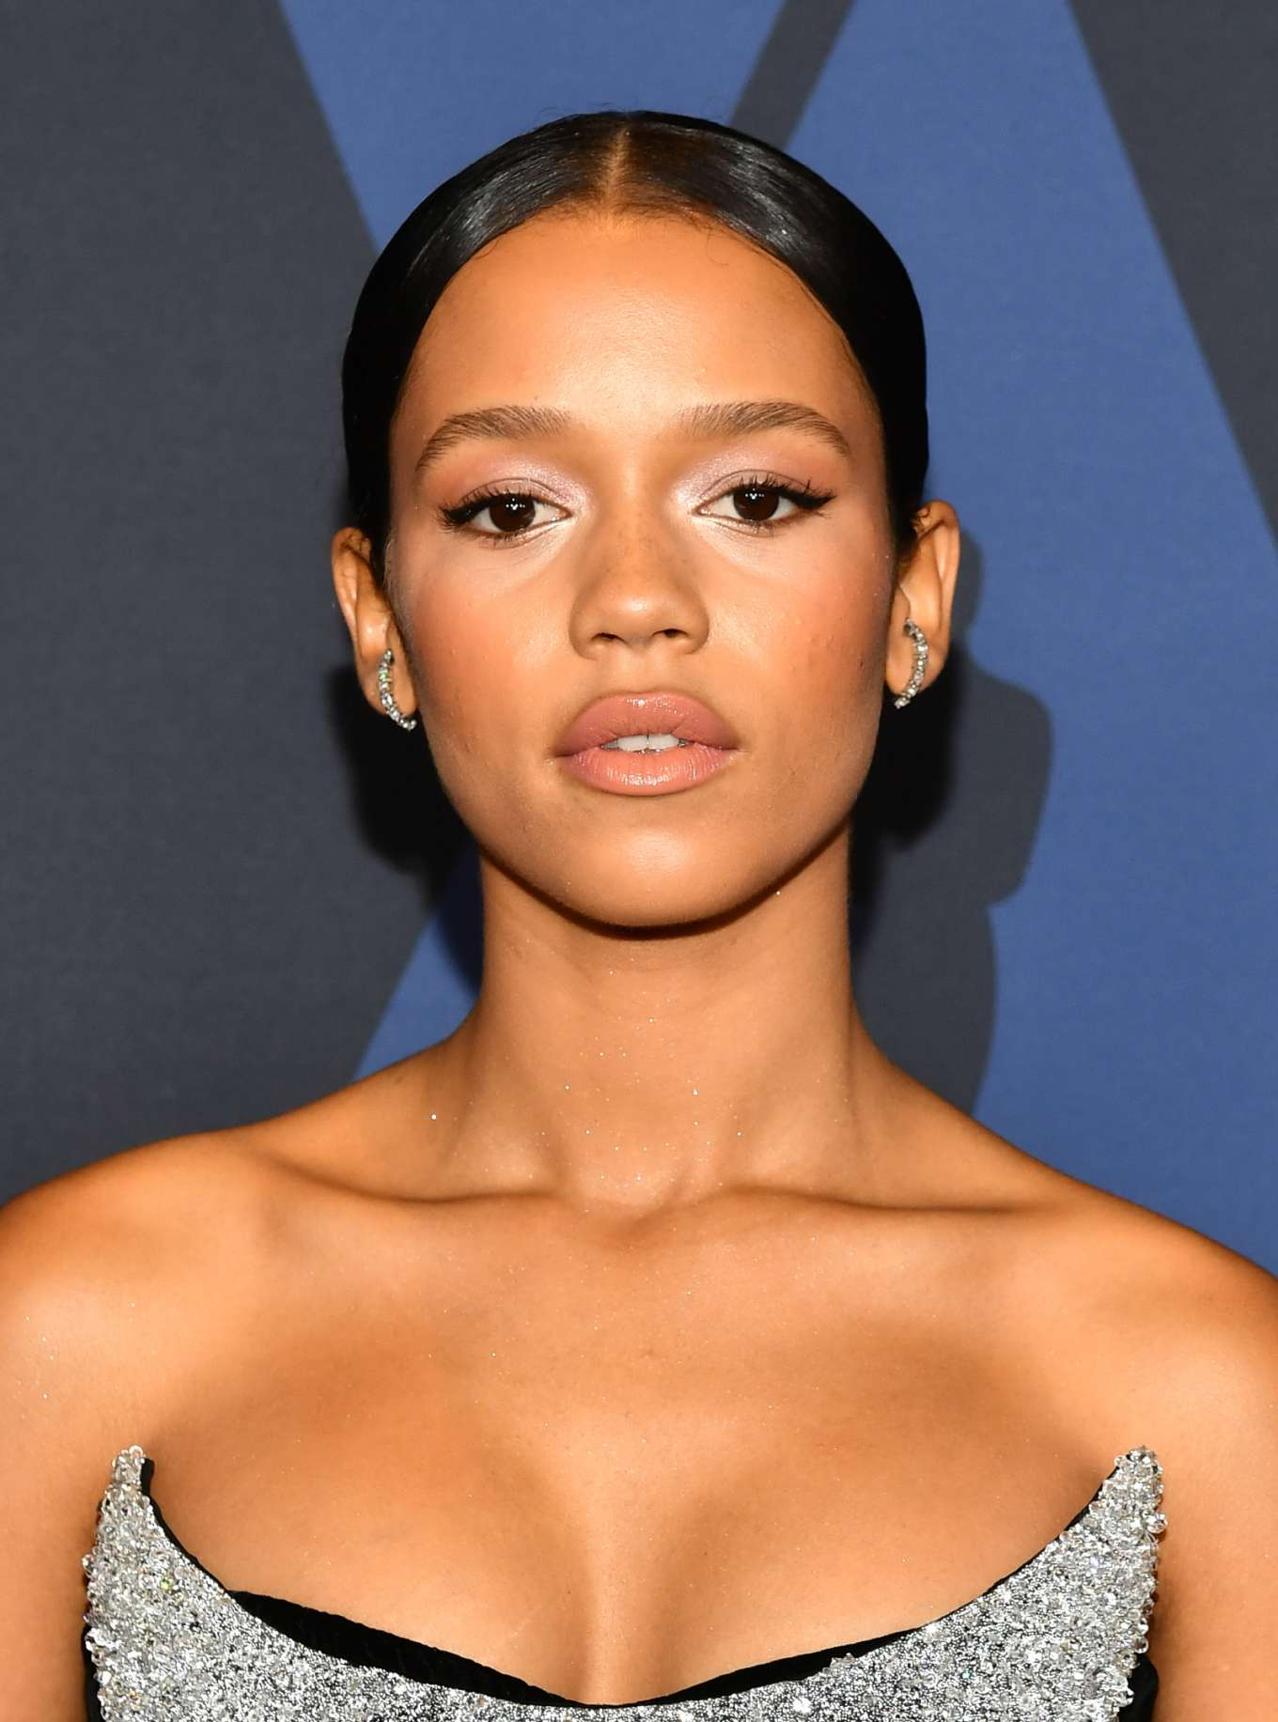
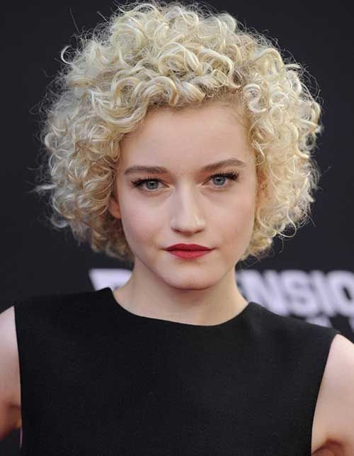

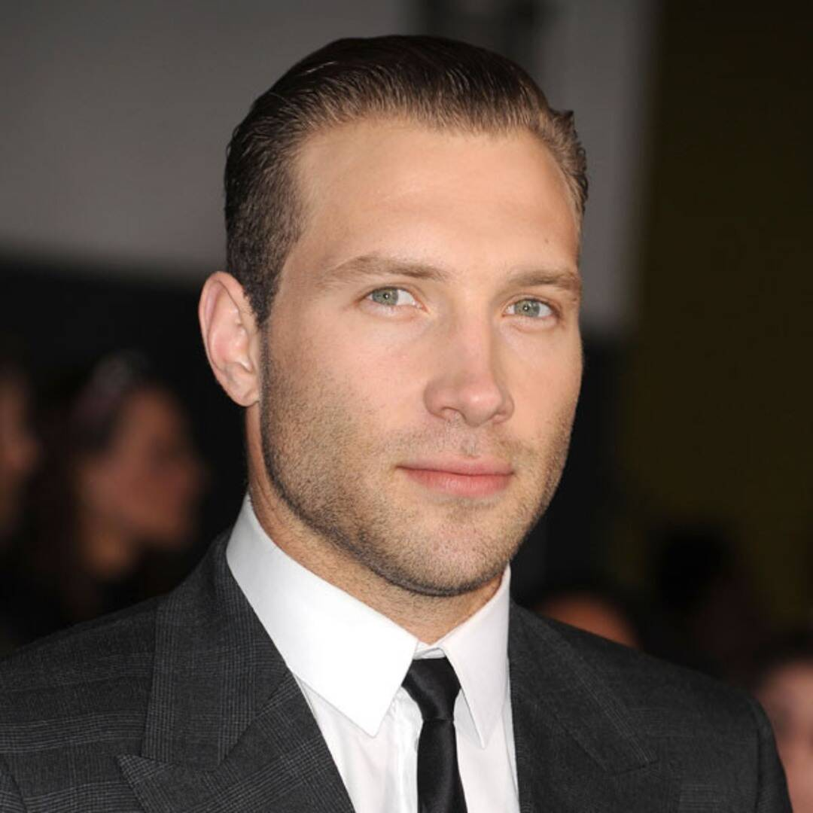
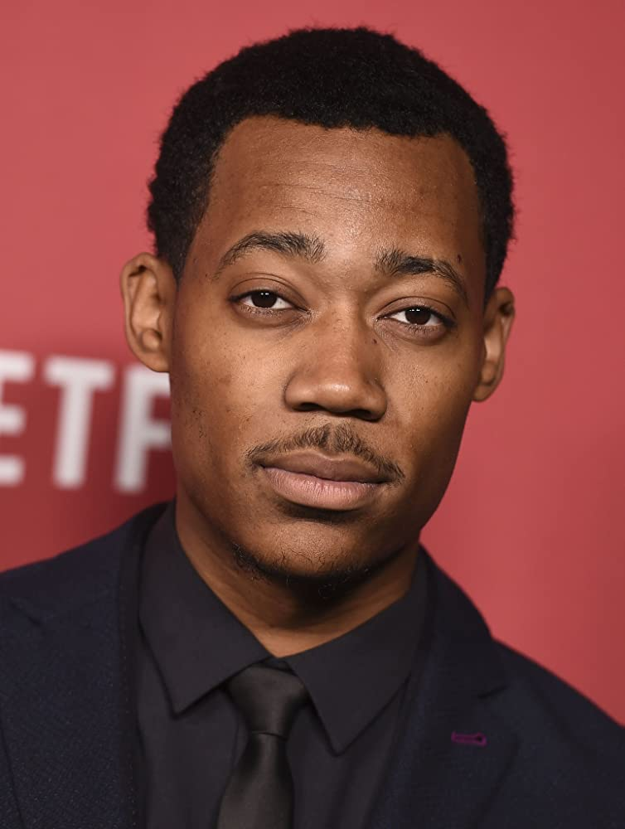
CHARACTERS
Simonne Tabb
Heather Baily
Lynn Bailey
Adam Chase
Hershey
A sincere music composition prodigy who becomes an acclaimed international DJ/Producer. As she wrestles with fame, and her troubled past, she is trying to determine what life would be like if she left the music scene behind.
A successful, smart, investigative journalist with an ear to the ground. She has always had a crush on Simonne, but she’s not sure this is the time to follow that lead. She begins to uncover a drug ring happening inside the music festival.
A sweet girl with a rough patch that becomes more evident with the extravagant journey in Simonne’s rise to fame. She pretends all the attention doesn’t bother her, but jealously, and drugs eventually leads to her dimise.
Simonne’s long time manager, and friend. He is helpful and friendly, if he knows you, or if you have good intentions. He loves the journey, and is very protective of Simonne.
A music promoter, who’s good at what he does. He’s charming, sincere, and an all around nice guy. He has to do what he has to do to get by in the crazy city of Miami. He means well, but he doesn’t always do the right thing.

Slide 6
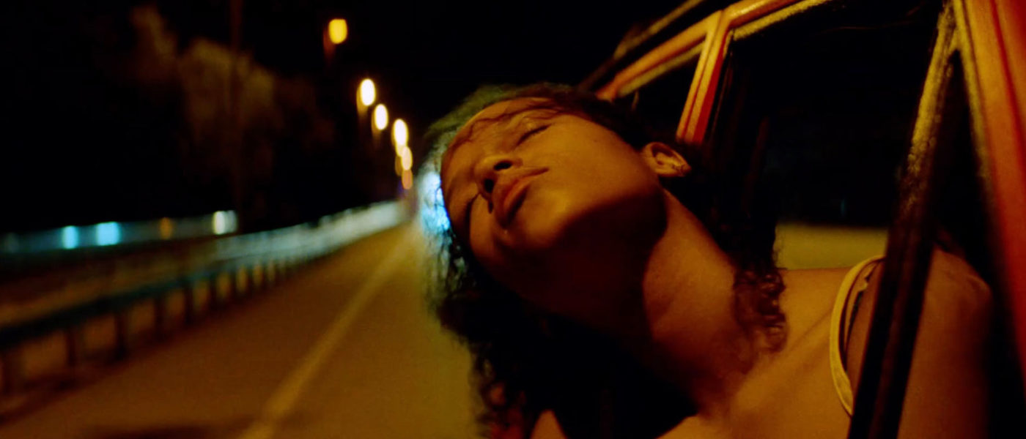






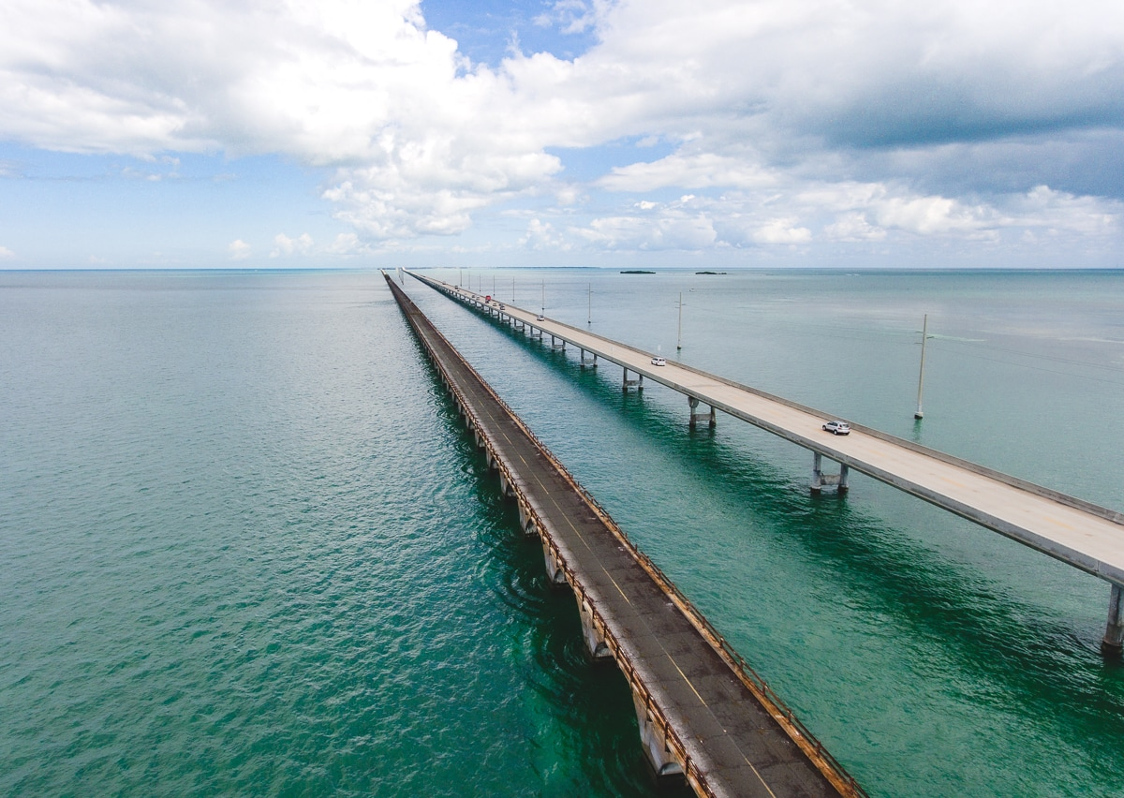


TONE
BOLD COLOURS, saturated blues, greens and reds, with a great deal of colour interludes.
STRONG CAMERA MOVEMENTS. Slow, circular, drawn out emotional movements, with tight personal engagements.

Slide 7
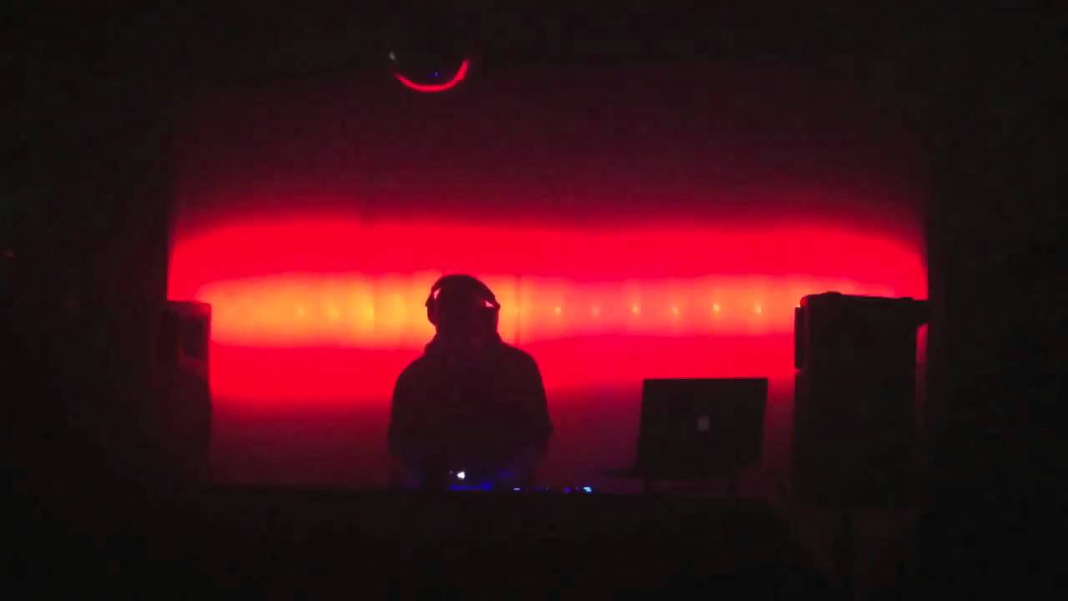

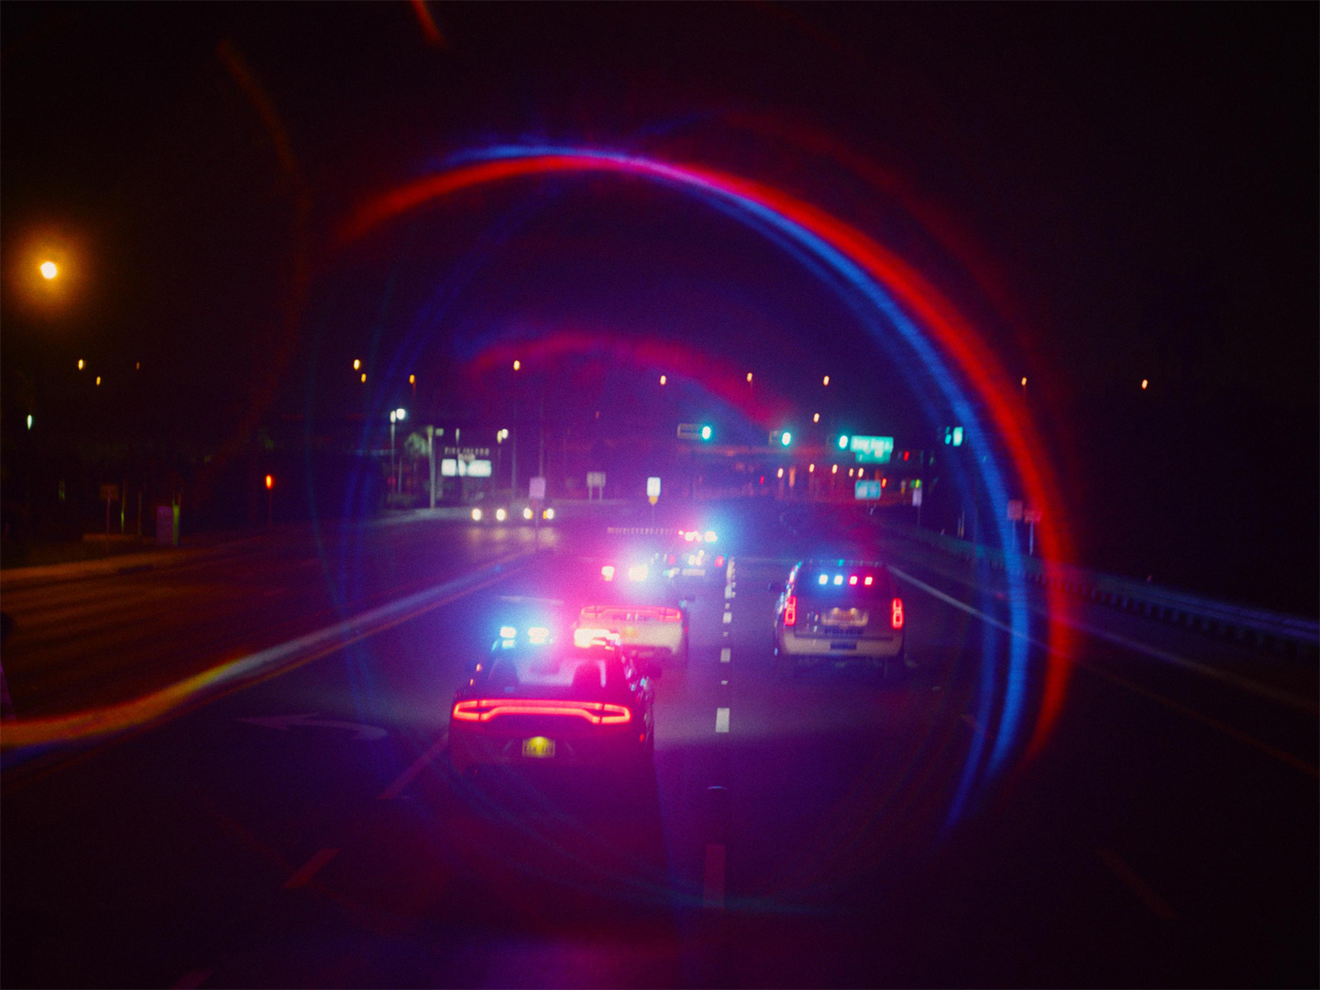

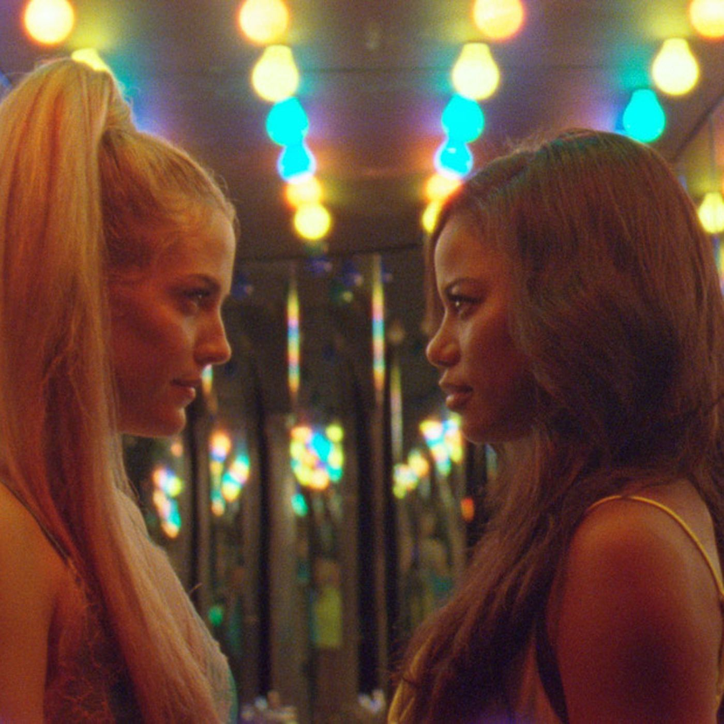
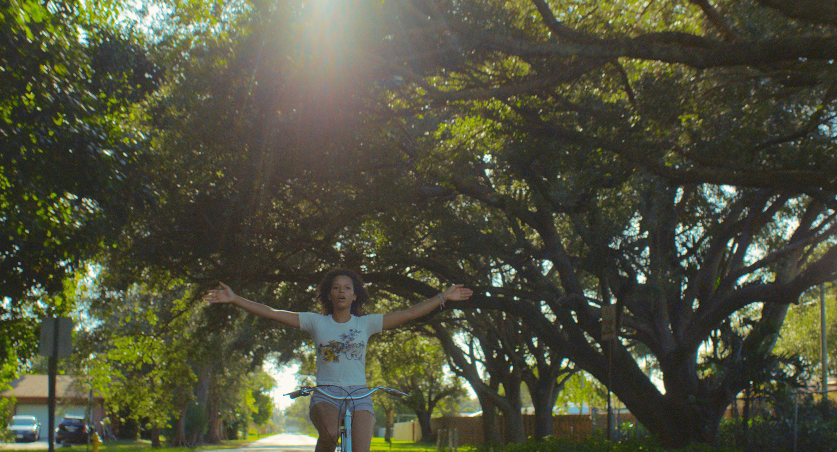
TONE CONT’D

Slide 8
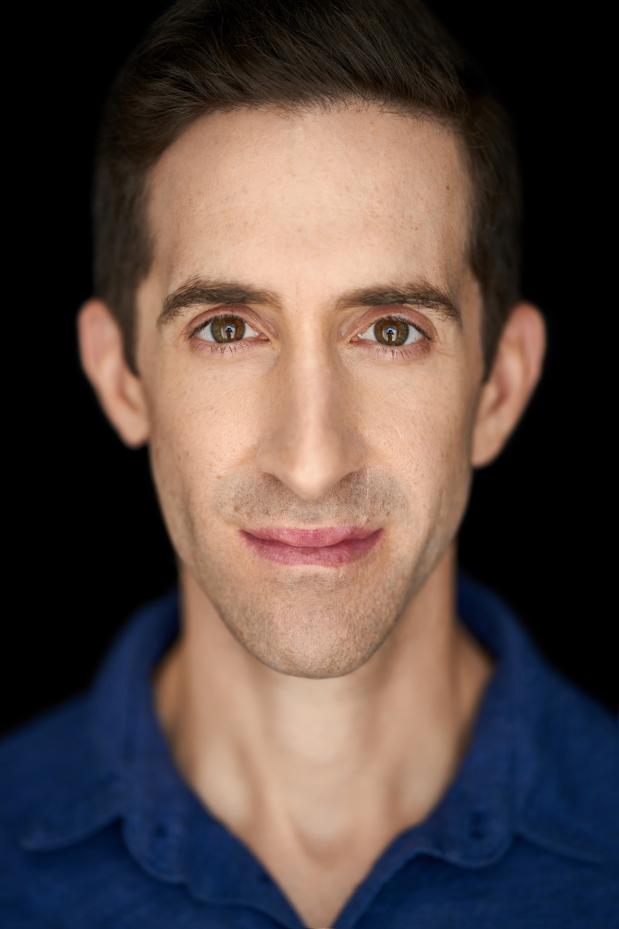
Filmmaker
Jonny Kidney - Writer/Producer
Jonny Kidney is a graduate of Broadcast and Online Journalism at BCIT, and VSF, and has worked in the Film and Television, and Tech industries for the past 7 years. If it’s one thing he knows and does well, it’s the organization to write, produce and deliver compelling, engaging content. He has the skills to master and guide media platforms, storytelling and video content in a clear and organized manner. With his experience in filming news stories, documentaries, giving interviews and editing, he possesses a wide array of skills needed to produce and guide a project from start to finish.
Jonny is a producer with CTM Media.
Jonny prides himself on his collaborative relationships with colleagues and crews. As a producer, and writer, he has planned, coordinated and orchestrated filming of various marketing campaigns for a wide array of clients stemming from the provincial and municipality sector to corporate and private companies, and products.

Slide 9
DROP
By Jonny Kidney
Jonny Kidney – Writer/Producer
jonnykidney@gmail.com
P: 604-561-5976
Jonnykidney.com

