Slide 1
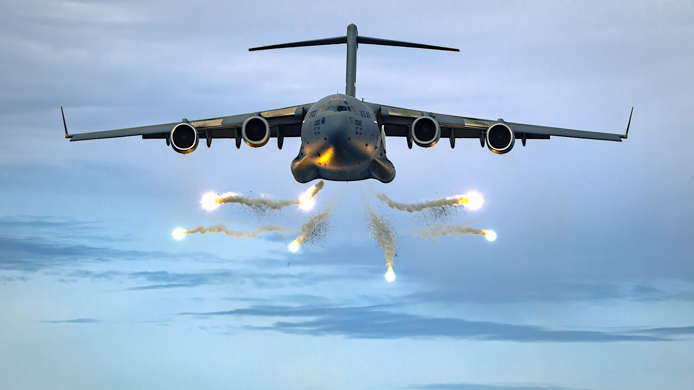
CARGO KINGS Delivering Where No One Dares
Notes:
Photo by Jakob Owens on Unsplash

Slide 2
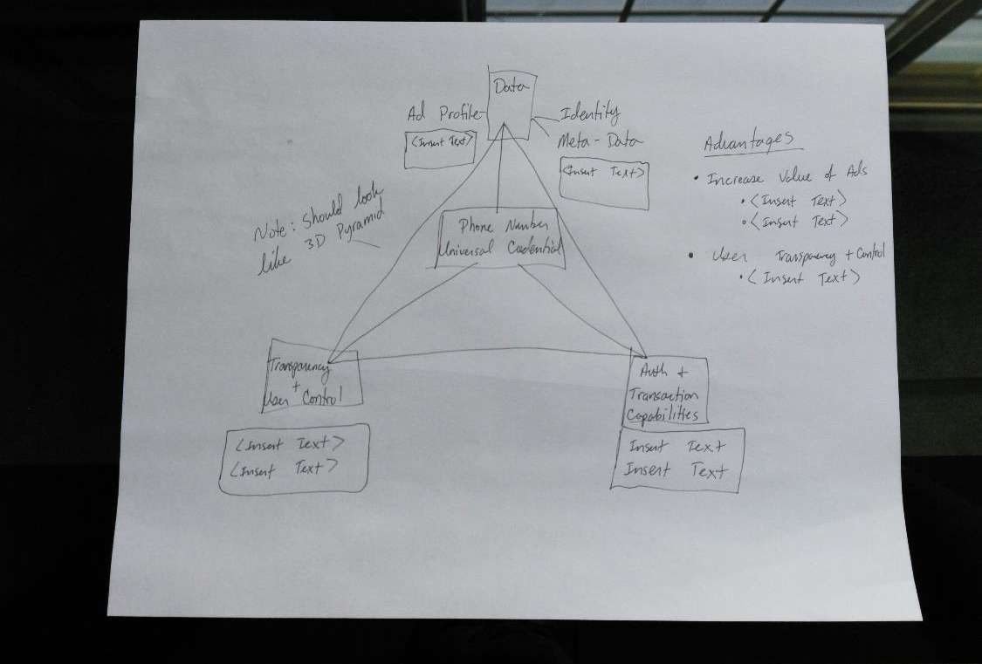
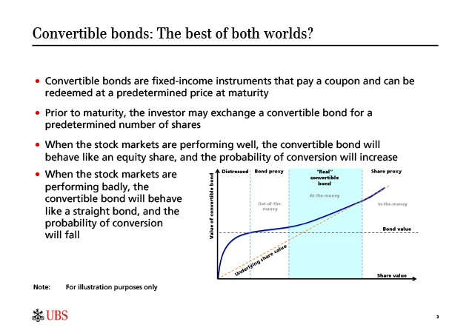

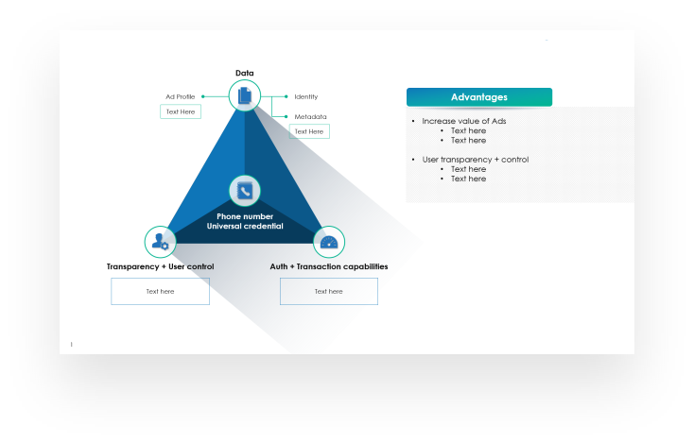
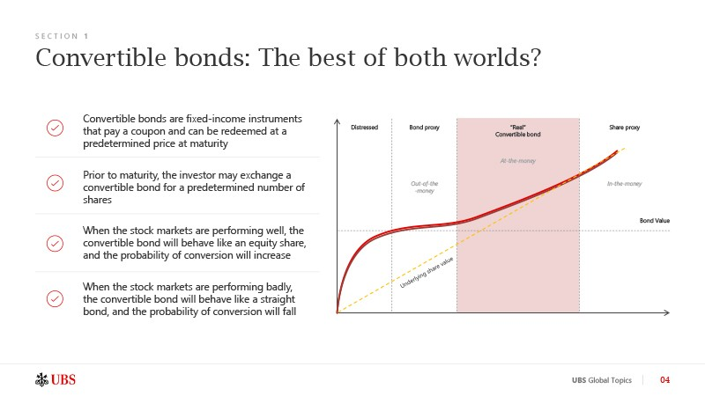
LET US DO YOUR PRESENTATION
before
before
24 HOUR
TURN AROUND
From $11
PER SLIDE
GET STARTED
after
after
Go to 24Slides.com/order
to find out more

Slide 3

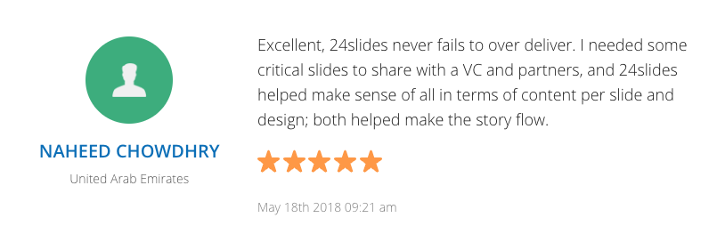

With a full team of designers, we produce hundreds of thousands of slides each year, in dozens of languages, for thousands of clients around the world.
Get Started
Go to 24Slides.com/order to find out more

Slide 4







A SOLUTION FOR YOUR ENTIRE TEAM
$899
$1,900
$3,900
ENTERPRISE
month
month
month
10 Slides / day
From $4.5 per slide
24 hour turn around
Dedicated Team
25 Slides / day
From $3.8 per slide
24 hour turn around
Dedicated Team
60 Slides / day
From $3.2 per slide
24 hour turn around
Dedicated Team
NEED MORE SLIDES?
Ask us about special enterprise pricing.
As used by
Go to 24Slides.com/sales to find out more

Slide 5
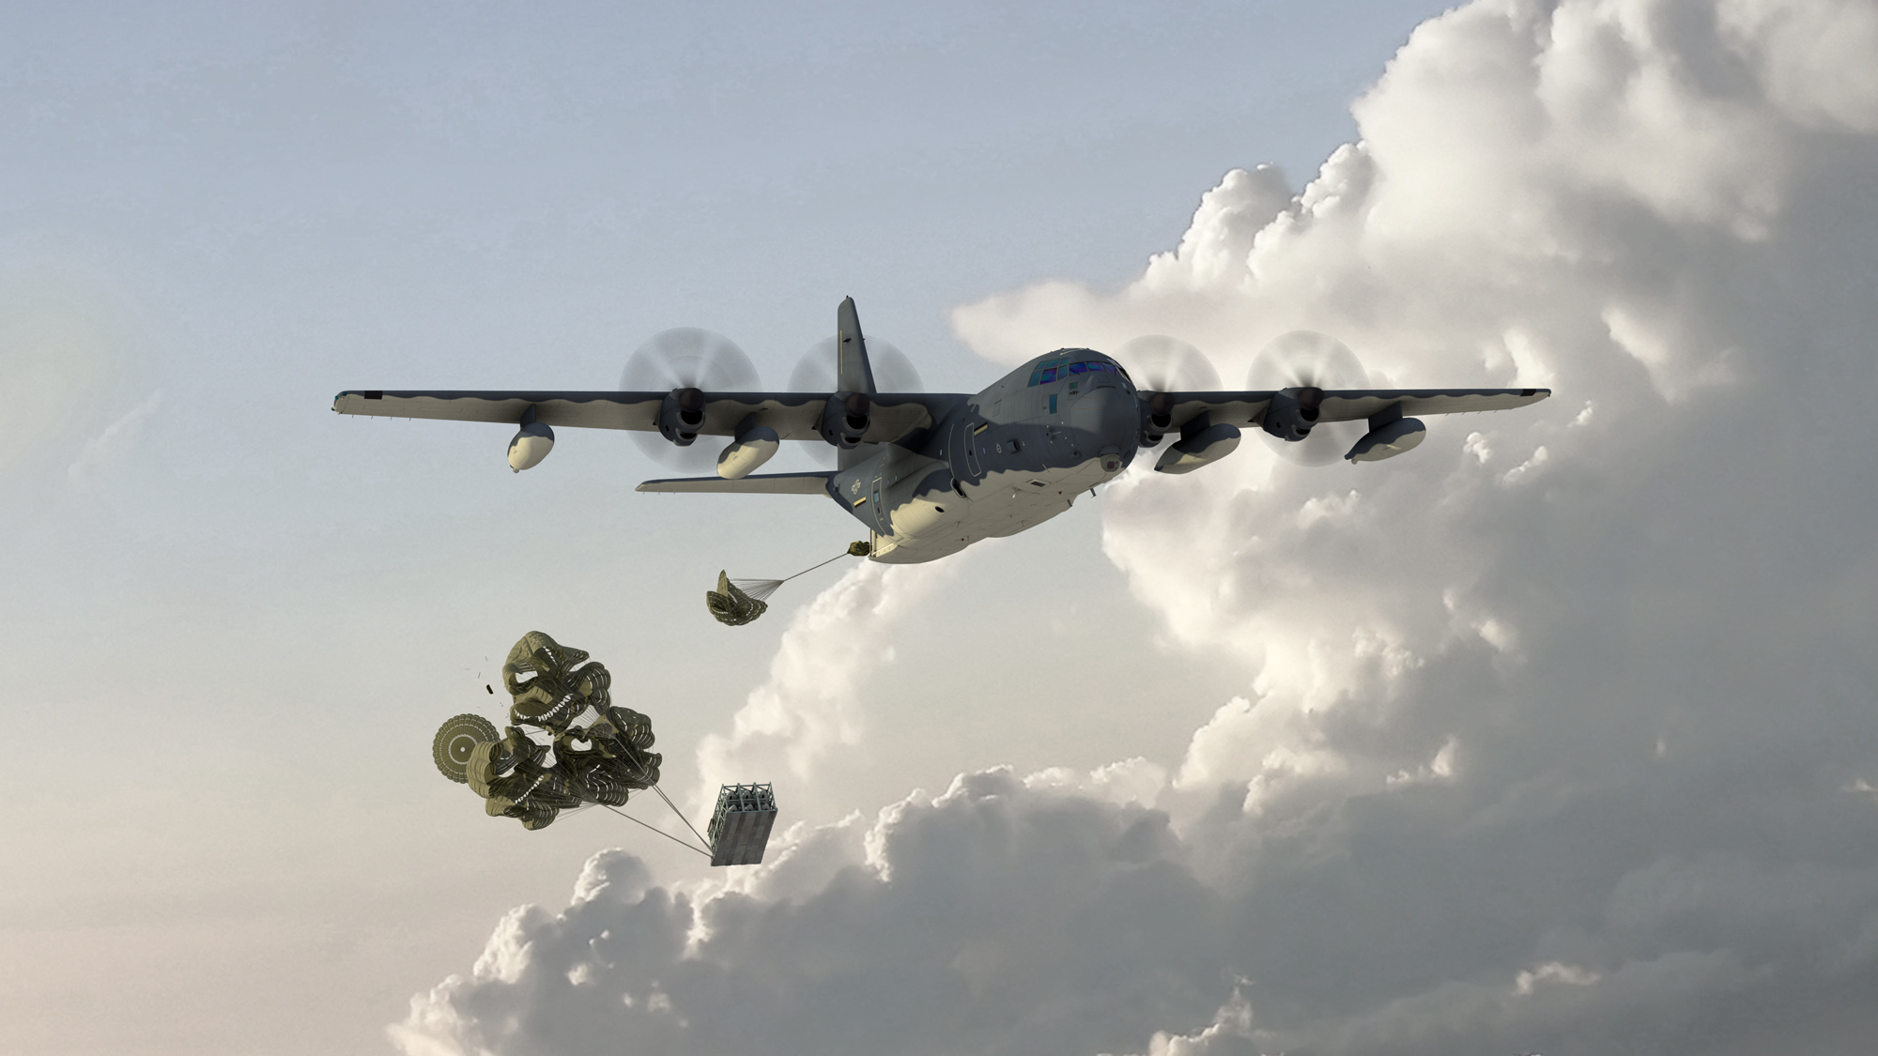
Introduction
The Challenge
Remote and Dangerous Deliveries
Our Vision
Cargo Kings – connecting remote area delivery needs with skilled pilots.

Slide 6
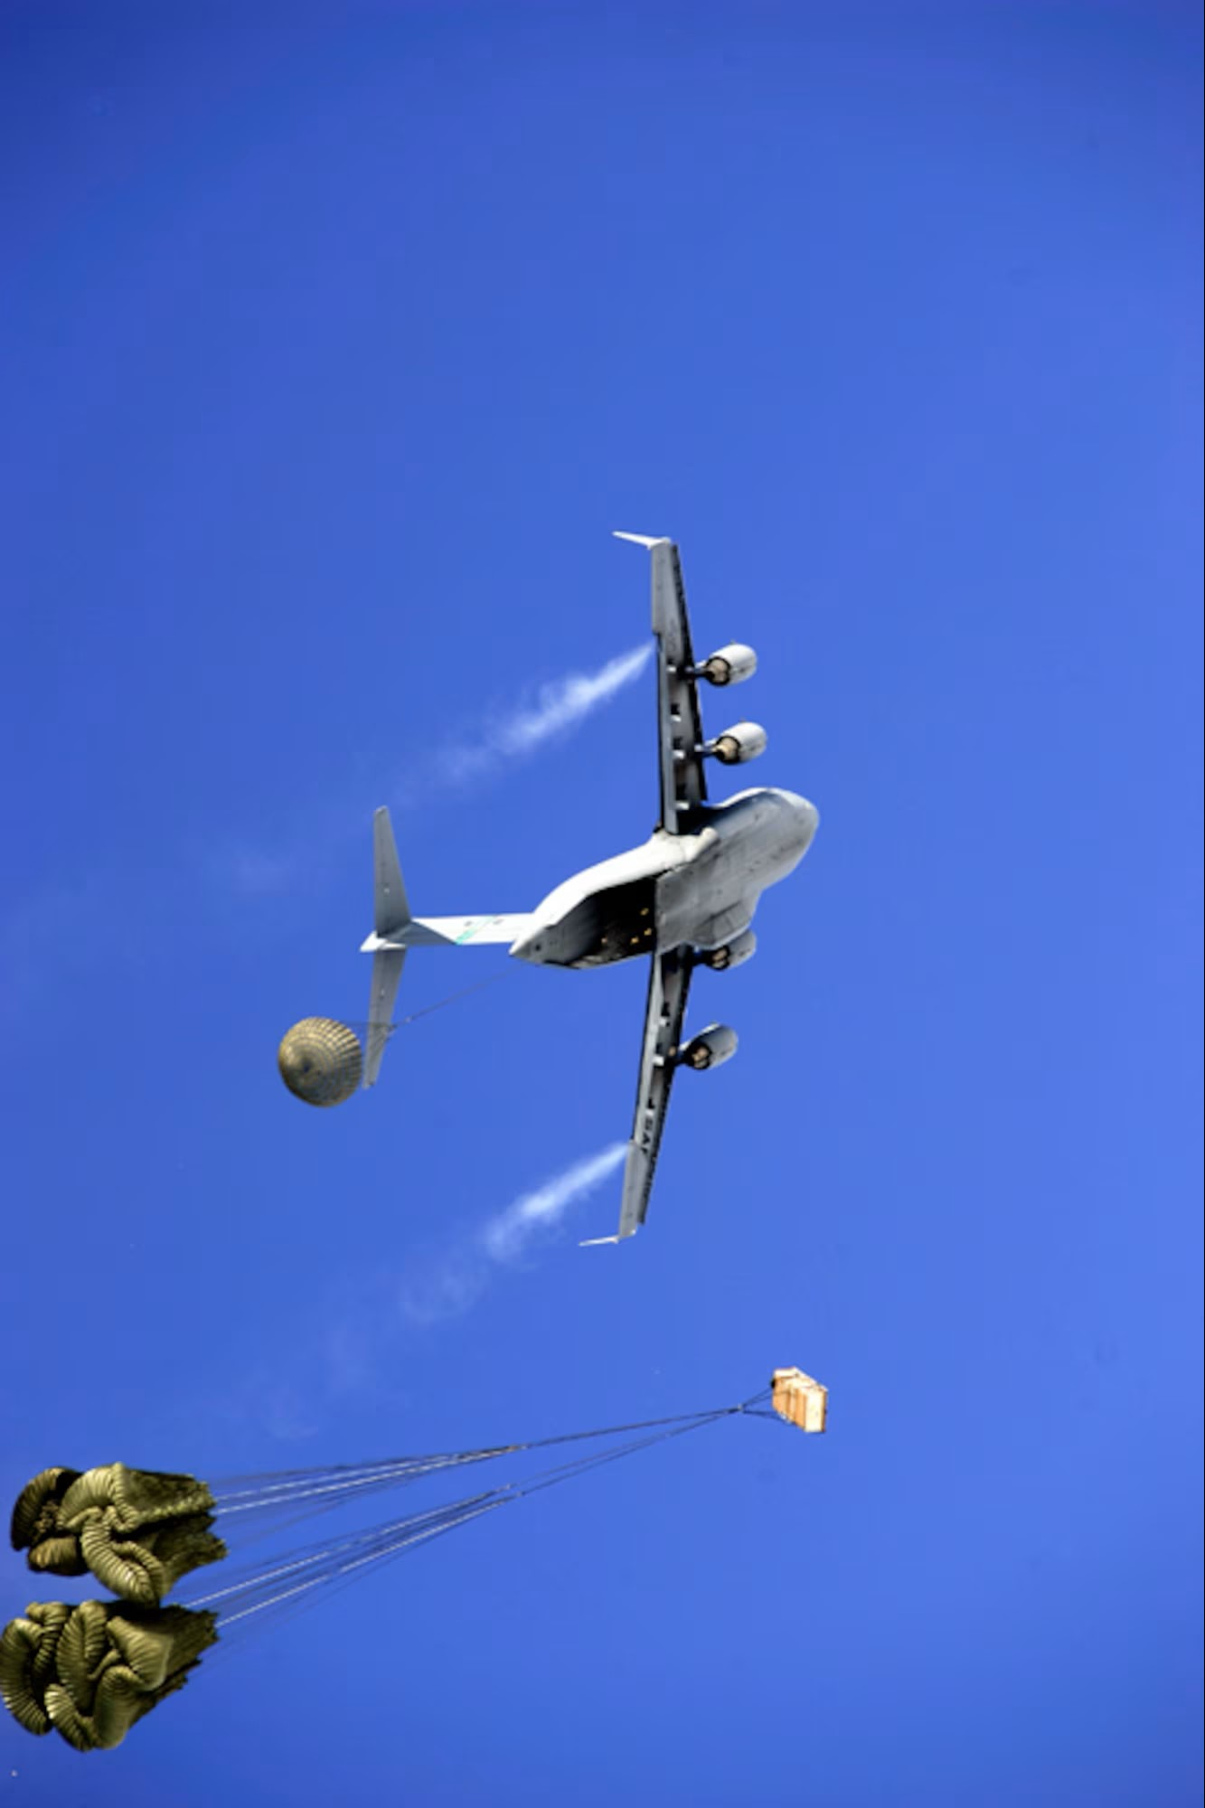
Cargo Kings: A Thrilling Journey
  Join us as we follow fearless pilots into the world's most perilous locations.
The Series
  Each episode showcases daring courier flights to remote areas.
Unique Selling Proposition
Why Cargo Kings?
  Unprecedented Access: We go where others can’t.
  High Stakes: The drama is real.
  Incredible Characters: Pilots who redefine courage.
SYNOPSIS
Notes:
Photo by Alberto Bigoni on Unsplash

Slide 7
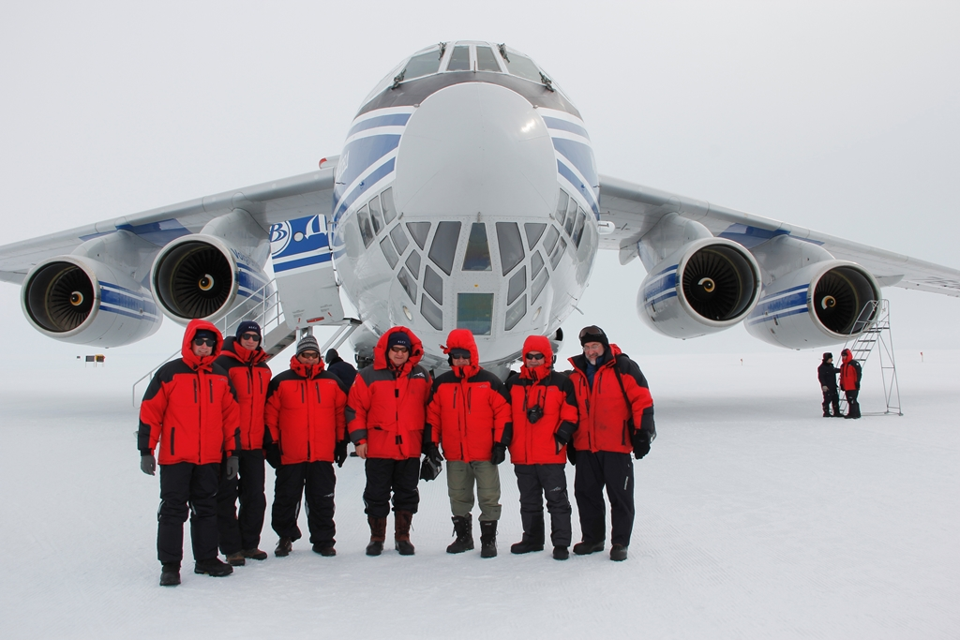
FORMAT
Episode Structure
  Each episode focuses on a different perilous delivery.
Story Arc
  Challenges, risks, and triumphs.
Behind the Scenes
  Meet the pilots, witness their dedication.
DIRECTED BY
PRODUCERS
EMILY TURNER
SARAH MITCHELL
EXECUTIVE PRODUCER
WRITTEN BY
JOHN DOE
JOHN DOE
Notes:
Photo by Kyle Head on Unsplash
Icons made by <a href="https://www.flaticon.com/authors/freepik" title="Freepik">Freepik</a> from <a href="https://www.flaticon.com/" title="Flaticon"> www.flaticon.com</a>

Slide 8
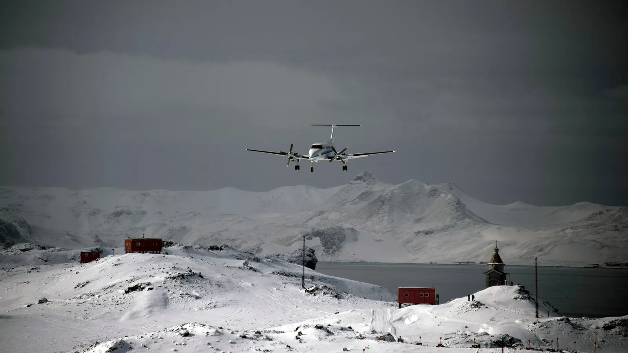
Locations
Format
Global Adventure
  Journey to the world's most remote and dangerous places.
Featured Locations
  The Arctic, Northern Territories, East Timor, Faroe Islands, Sub-Saharan Africa, etc.
Episode Structure
  Each episode focuses on a different perilous delivery.
Story Arc
  Challenges, risks, and triumphs.
Behind the Scenes
  Meet the pilots, witness their dedication.
Notes:
Photo by Filipe de Rodrigues on Unsplash

Slide 9
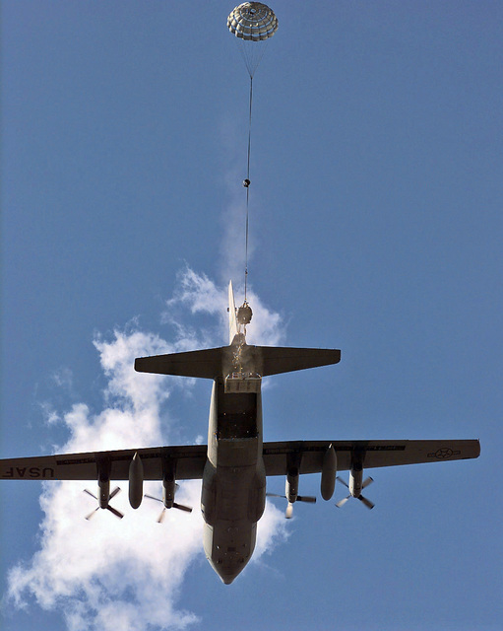



CARGO AIRLINE
CARGOJET CANADA
Cargojet Inc. is a scheduled cargo airline based in Mississauga, Ontario, Canada. It operates cargo services in Canada and internationally, as well as full aircraft charters. Its main base is John C. Munro Hamilton International Airport. Cargojet is a public company with over 1650 employees.
Notes:
Photo by Filipe de Rodrigues on Unsplash

Slide 10
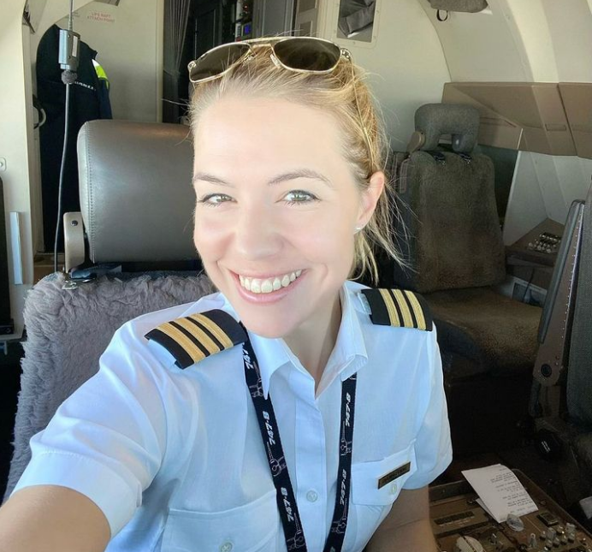
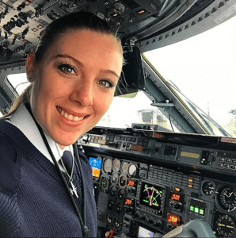

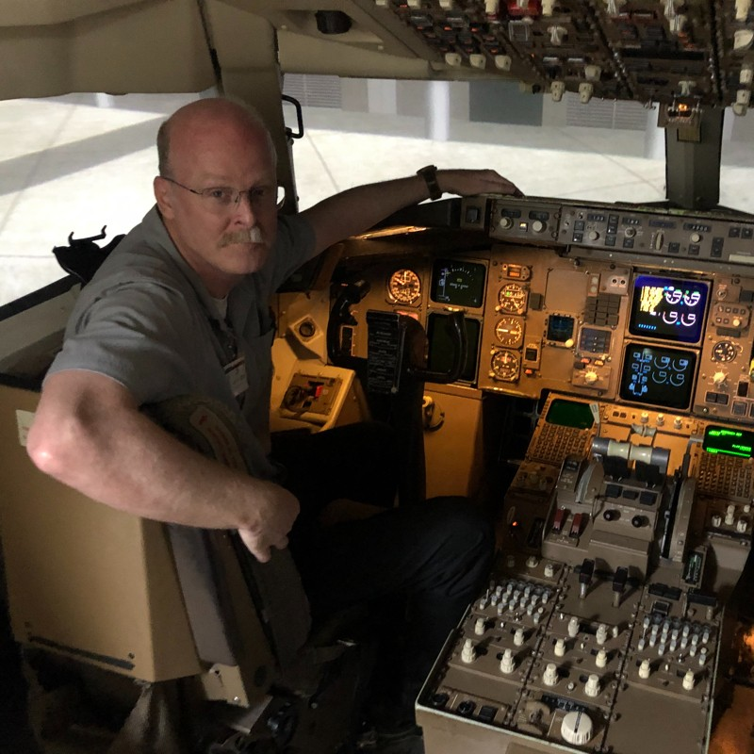
MEET THE CARGO KINGS
Eva Claire “Maverick” Marseille
Kayleigh “Stormrider” Bordner
Alvin “Skyhawk” Soriano
Ian “Bravo” Brady
A fearless and rowdy female cargo pilot who defies convention and takes the aviation world by storm. With a mane of fiery red hair and a personality to match, she's a force to be reckoned with in the skies.
A highly skilled and esteemed cargo pilot who has left an indelible mark on the world of aviation. With his unwavering dedication and passion for flying, Alvin is a true luminary in the skies.
Captain of B757 B767 at Cargojet with over 25 years of flying. With a personality as wild as the skies he navigates, Bravo has earned his reputation as a fearless, no-nonsense aviator who lives life in the fast lane.
A trailblazing force of nature in the world of aviation. With a fiery spirit and an insatiable appetite for adventure, she's not your typical cargo pilot.
Notes:
Photo by Unsplash

Slide 11




THE TEAM
Emily Turner
Sarah Mitchell
Sean Gomez
Lucas Wright
An avid documentary director whose passion for storytelling knows no bounds. With an unrelenting curiosity and a keen eye for capturing the essence of real-life stories, Emily has made her mark as a prominent figure in the world of documentary filmmaking.
An accomplished female documentary producer who has dedicated her career to bringing impactful stories to life. With an unyielding passion for storytelling, a razor-sharp sense of organization, and an uncanny ability to assemble talented teams, Sarah has made her mark as a driving force in the world of documentary production.
A seasoned documentary editor whose artistic sensibility and storytelling prowess have made him an essential figure in the world of non-fiction filmmaking. With an eye for detail, a deep understanding of narrative structure, and a commitment to bringing powerful stories to life, he is a master at transforming raw footage into compelling documentaries that resonate with audiences worldwide.
His artistic vision, technical expertise, and passion for visual storytelling have solidified his position as a vital collaborator in the world of documentary filmmaking. With a deep appreciation for the nuances of lighting, composition, and the human experience, Lucas is a master at capturing the essence of every subject he encounters through the lens of his camera.
DIRECTOR
PRODUCER
EDITOR
CINEMATOGRAPHER
Notes:
Photo by Unsplash

Slide 12
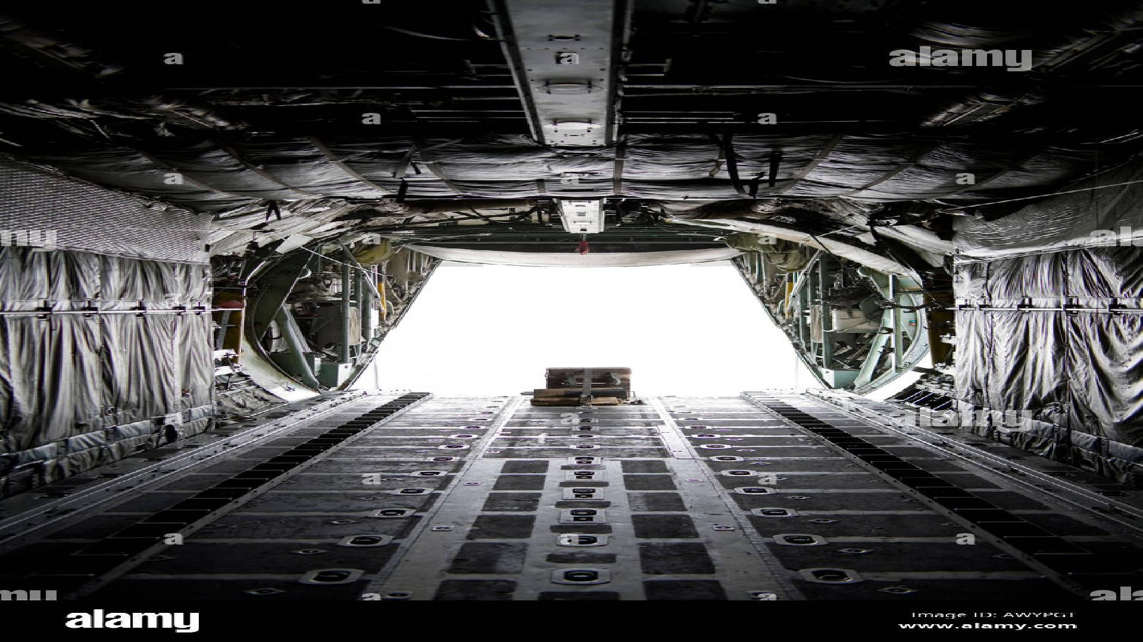

AUDIENCE APPEAL
Who Will Watch Cargo Kings?
Adventure enthusiasts
Aviation enthusiasts
Documentary lovers
REVIEW
Notes:
Photo by Daniel Cheung on Unsplash

Slide 13
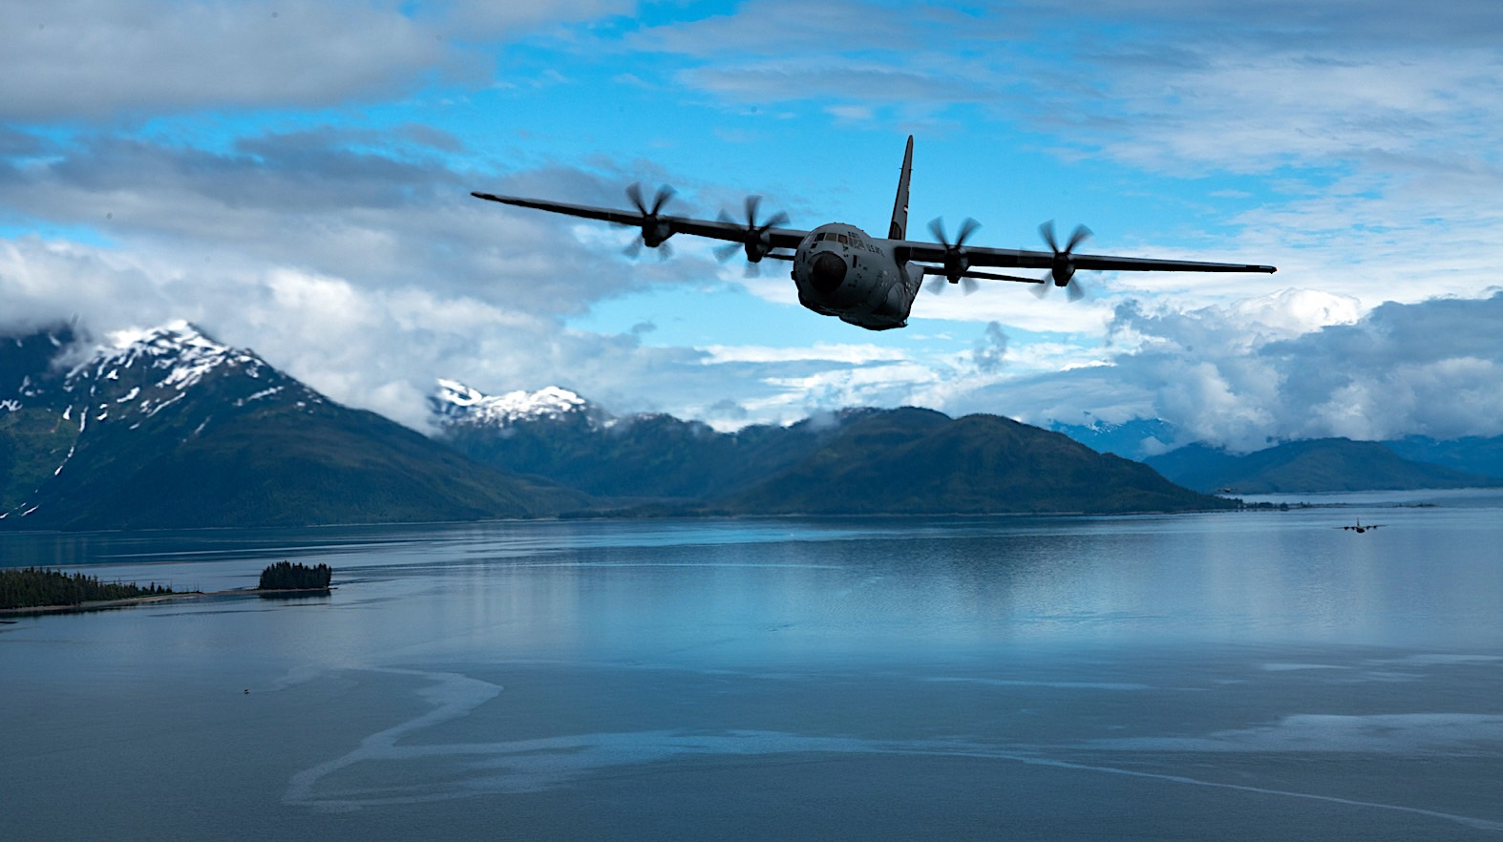
Thank you for considering Cargo Kings – The Series. We're ready to take viewers on an unforgettable adventure, showcasing the bravery of our pilots and the beauty of the world's most remote locations.
Notes:
Photo by Jakob Owens on Unsplash

Slide 14
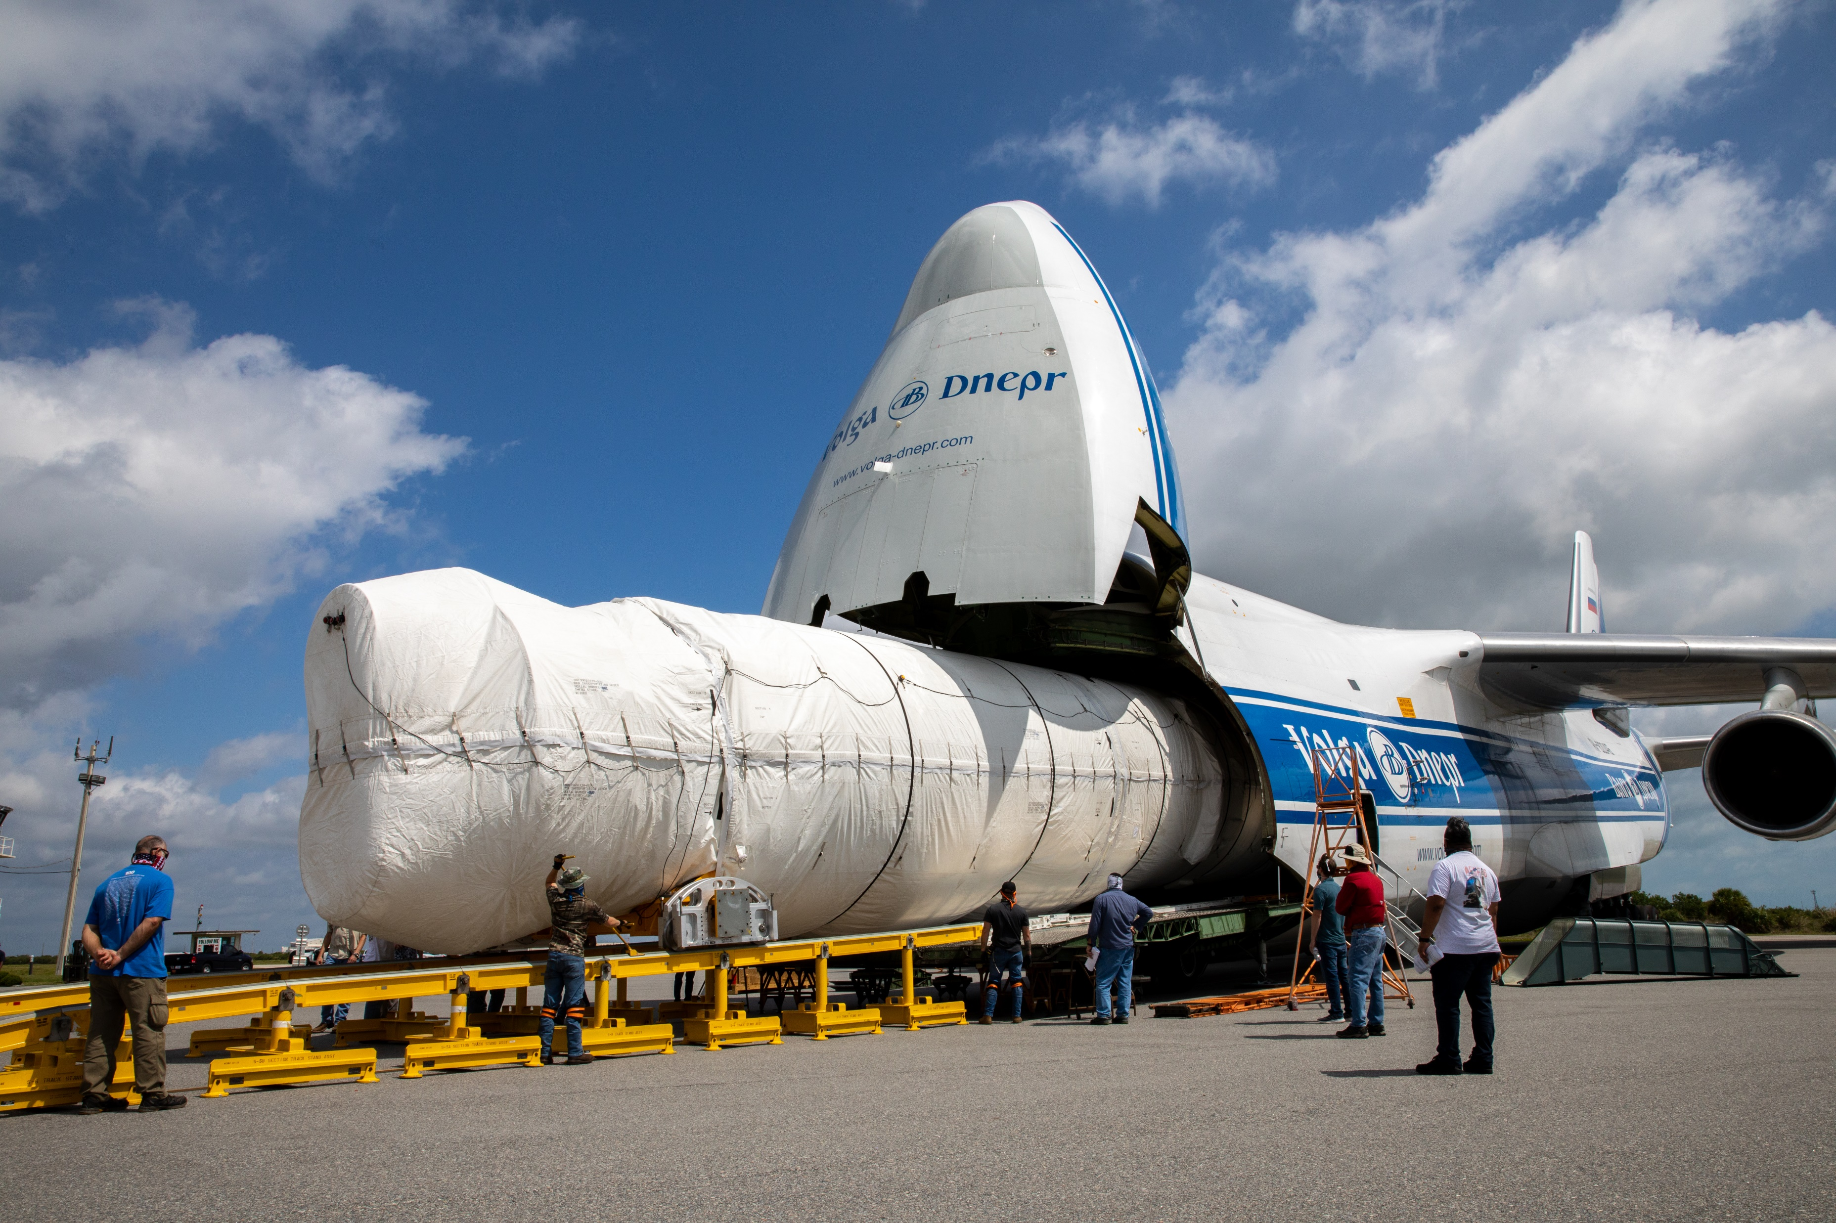
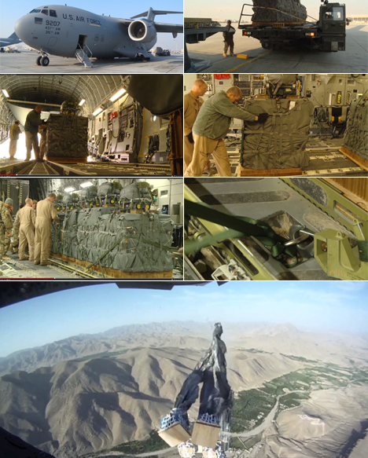
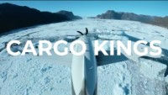
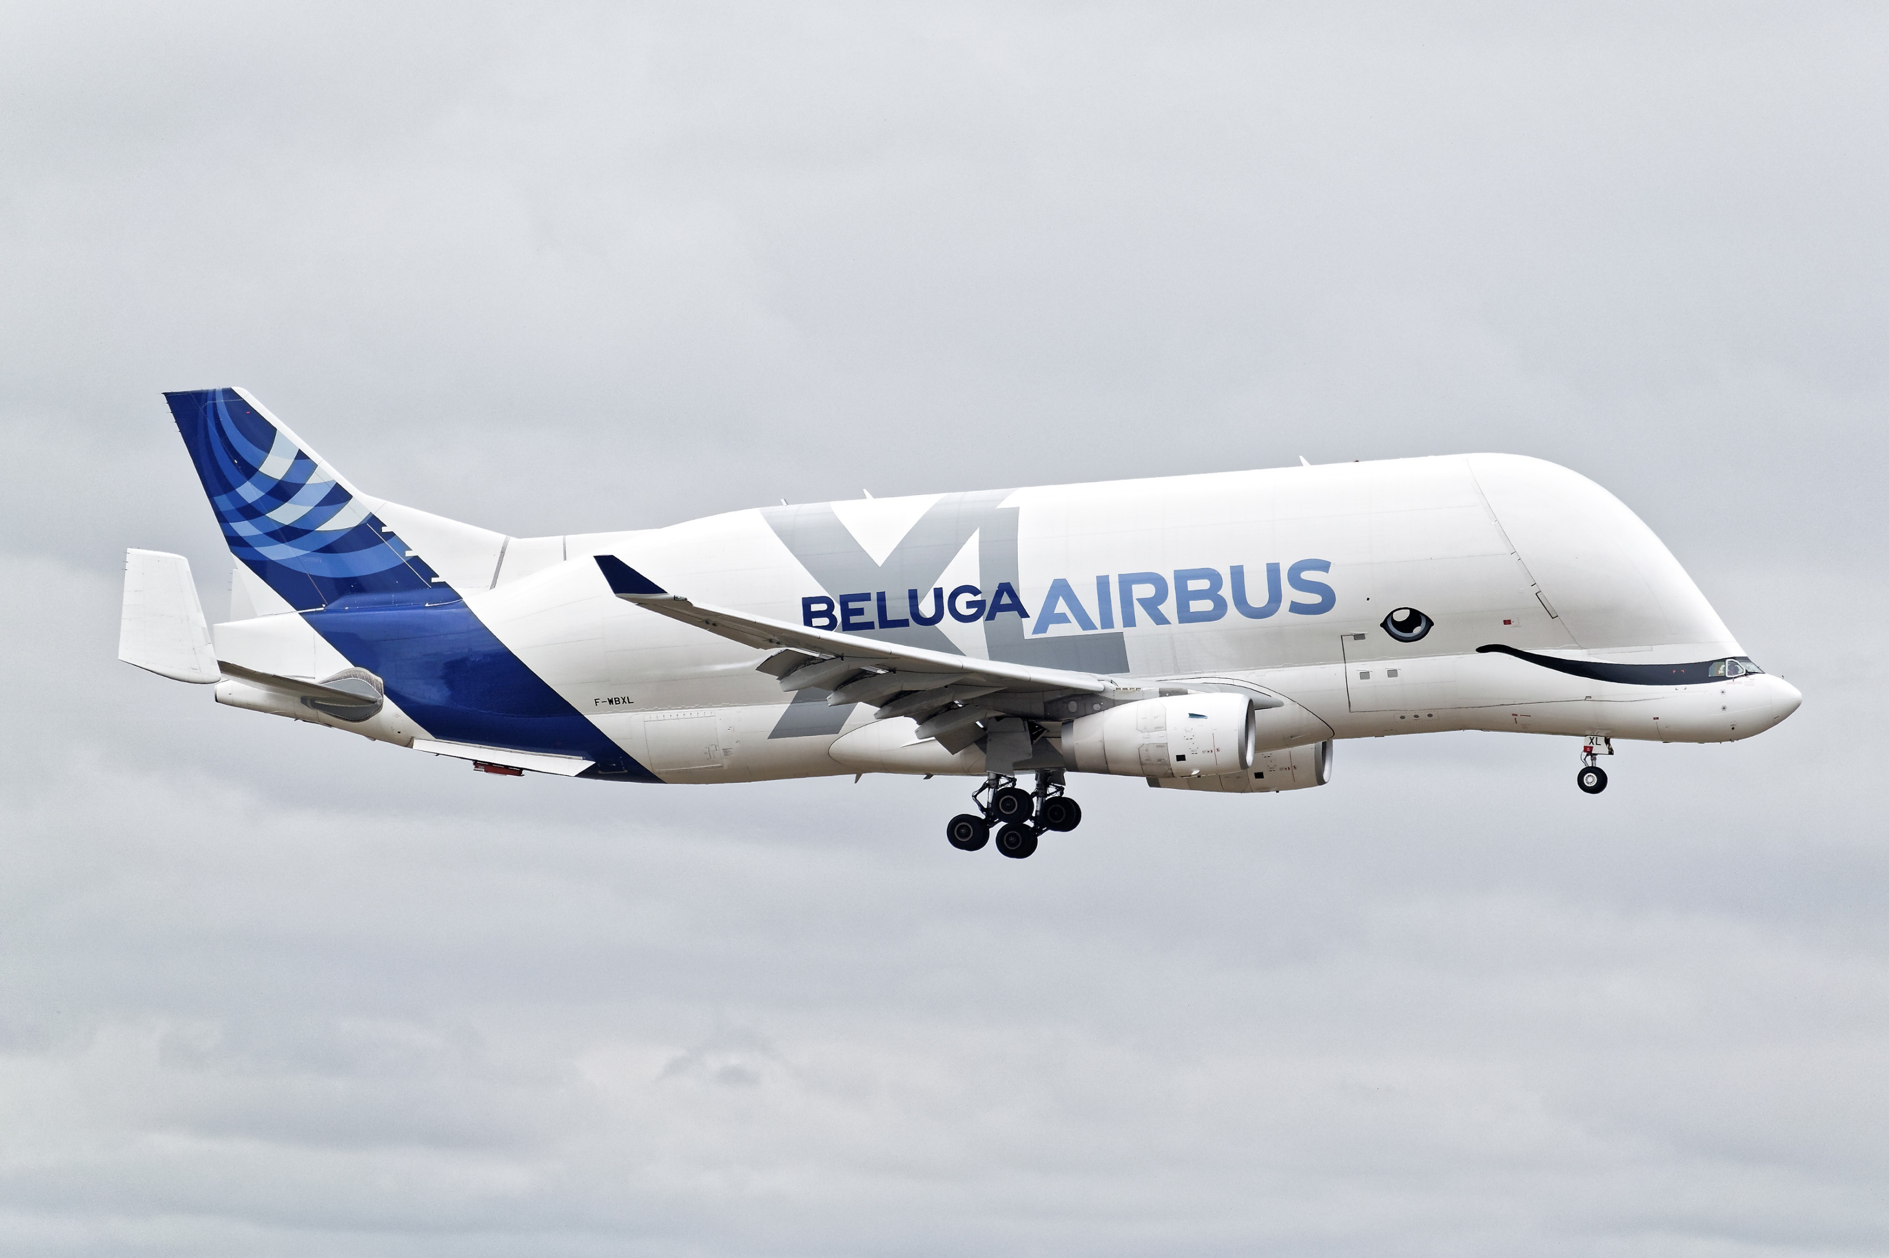
CONTACT
Get in Touch
  jonnykidney@gmail.com
Website
  Jonnykidney.com

